Slide 1
Conda Virtual
Environments
Introduction

Slide 2
Virtual Environments

Slide 3
What are virtual environments?
Basically: isolated instances of software (the software is stored in dedicated folders)
Normally, software is installed directly on the operating system
Virtual environments allow you to install software that will only be used while within the environment.
libs & deps
VEnv. 1
VEnv. 2
libs & deps
libs & deps
libs & deps
Host OS
While outside the virtual environment, normal system software is used
Hardware
Host OS
Hardware

Slide 4




Why you should virtual environments
Best practice
For every project, create a corresponding virtual environment
Manage package dependencies:
Easier reproducibility:.
Keep OS software lean & clean:.
Often different projects will require different version of the same software.
Using virtual environments allows you the install the version you need for your project.
By keeping all your software for a specific project within a virtual environment, it is easier to keep track of required software and specific versions. This will make it easier to remake the environment.
Installing different versions of the same software on your OS can get messy and have unexpected consequences and installing everything directly on your OS can cause the system to get bloated.
VEnv. 1
VEnv. 2
VEnv. 1
libs & deps
Python 2.7
Python 3.6
VEnv. 1
Host OS - 1
libs & deps
Host OS
Host OS
VEnv. 3
Hardware - 1
Hardware
Hardware
Host OS - 2
Python 3.10
Hardware - 2

Slide 5
Conda & Mamba

Slide 6


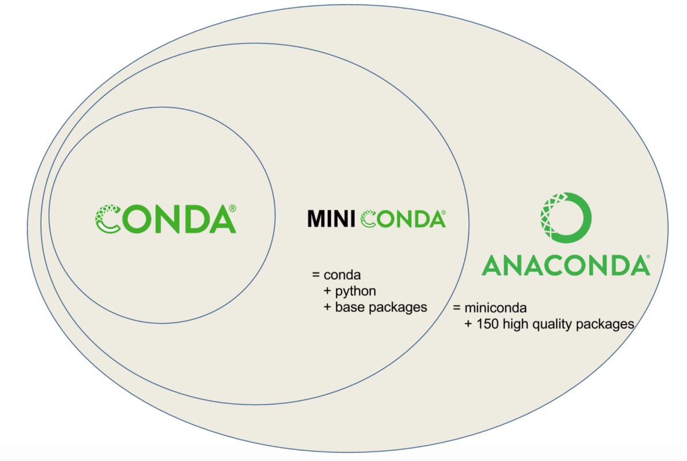
What is conda/mamba?
conda is one of the most popular python package & environment management tools for data scientist.
Mamba is a reimplementation of the conda package manager in C++ (meaning it’s much faster).
However, it cannot to do EVERYTHING conda can.
General rule:
Use ‘mamba’ for installing software (this includes creating new environments)
Use ‘conda’ for everything else

Slide 7
Why you should use conda/mamba
Can install python packages
Can install non-python packages
Can use pip
Can create virtual environments
Checks dependencies

Slide 8
Setting up conda & mamba

Slide 9
Installing conda & mamba
1. Install conda by follow installation instructions here:
https://conda.io/projects/conda/en/latest/user-guide/install/index.html
You will be told asked to download a file and run it
2. After installing conda, install mamba by running:
conda install mamba -n base -c conda-forge
More information on mamba can be found here:
https://github.com/mamba-org/mamba
Hints
I recommend (and use) ‘miniconda’ over ‘anaconda’ because it is more lightweight. Anaconda is a much larger file with many pre-installed packages that you may not need.
If you are using Windows, I recommend installing WSL (Windows Subsystem for Linux) with Ubuntu and installing conda (Linux_ on WSL Ubuntu. Instructions for setting up WSL can be found here: https://ubuntu.com/wsl

Slide 10
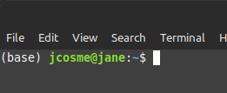
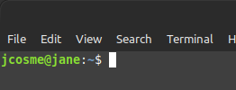
Setup Hints
In general, you should never install anything in your ‘base’ environment (installing mamba is an exception).
Conda installs from ‘channels.’
If you are going to use GPUs, you might also want to add the NVIDIA channel and the Rapids.ai channel.
By default, after installing conda, the ‘base’ environment will always be active when you open a terminal window.
conda config --add channels nvidia
conda config --add channels rapidsai
The most popular channel is ‘conda-forge.’ It is a good idea to always add this channel to conda.
You can change this setting by running the following:
conda config --add channels conda-forge
conda config --set auto_activate_base false
Note: the ‘--add’ flag will, in addition to adding the channel, make it the highest priority channel.
Since we want the highest priority channel to be ‘conda-forge’ we should add it last.

Slide 11
Overview

Slide 12
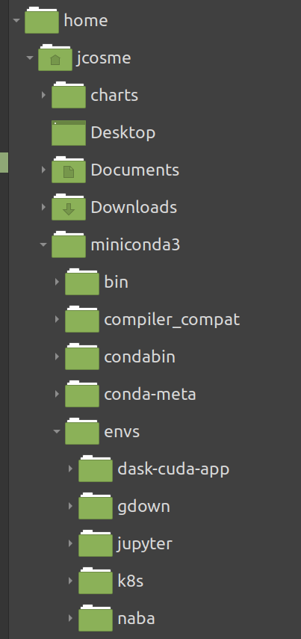
To use:
1. Create an environment
2. Activate the environment
Conda will store your environments in the ‘envs’ folder, within the conda software folder (called ‘miniconda3’ in my case).
In order to install packages or use an environment, it must be activated first
3. Install your packages
Install any software or packages you want within the activated environment
4. Use the environment
Run your scripts or start your applications from within the activated environment

Slide 13
The 3 main commands:
1. To create an environment, use: mamba create
You can install packages when creating a new environment by specifying the package name(s) afterwards
mamba create -n {your-env-name}
mamba create -n {your-env-name} {package-name-1} {package-name-2}
You can install a specific version by adding the ‘=‘ sign, followed by the version (no spaces)
2. To activate an environment, use:
conda activate
mamba create -n {your-env-name} {package-name}={version}
conda activate {your-env-name}
mamba install {package-name}={version}
3. To install packages in an active environment, use: mamba install
You can install from a specific channel by using the ‘-c’ flag, followed by the channel
mamba install {package-name}
mamba create -n {your-env-name} -c {a-channel} {package-name}
To install packages in a specific, non-active environment, add the ‘-n’ flag, followed by the environment name
mamba install -c {a-channel} {package-name}
Here are a couple of examples:
mamba install -n {an-env-name} {package-name}
mamba create -n my-proj -c conda-forge python=3.8 pandas
mamba install -c conda-forge python=3.8 pandas

Slide 14
Other important commands:
To deactivate an environment, use: conda deactivate
To remove packages, use: mamba uninstall
conda deactivate
mamba uninstall {package-name}
To view all environments, use: conda env list
To export an active environment**, use: mamba env export
conda env list
mamba env export > {env-export-file-name}
To delete an environment, use: conda env remove
To re-create an exported environment**, use: mamba env create
conda env remove -n {your-env-name}
mamba env create -f {env-export-file-name}
**More information on ‘exporting’ to follow

Slide 15
Exporting & recreating environments

Slide 16
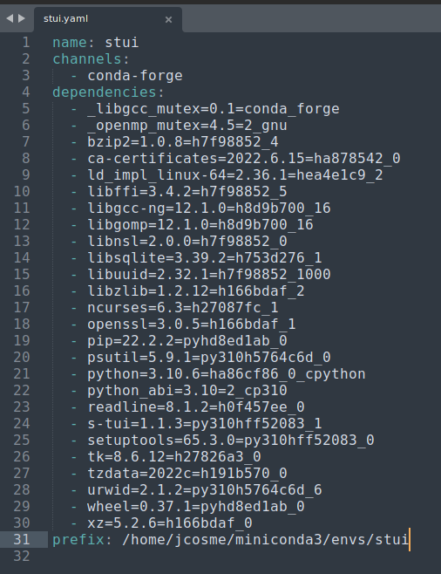
What is exporting conda environments and why do it?
Exporting an environment creates a file (yaml) that lists all the packages and version that are installed in that environment. It will also save the channels, and any environment variables saved to the environment.
This file can be saved to a repository of your project code for others to be able to easily create an environment that will successfully run your code.
Can also be used by you to recreate the environment, in the case where you have not touched the code for years and need to once again work on it.
Can also be used in docker image creation whenever you need to containerize your code.
Allows you to remove the conda environment (and free up space) once you are finished working on the project.

Slide 17
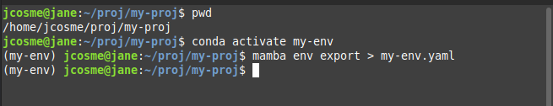
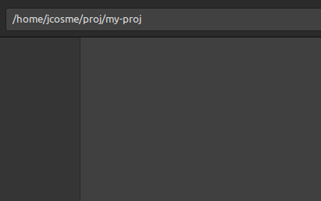
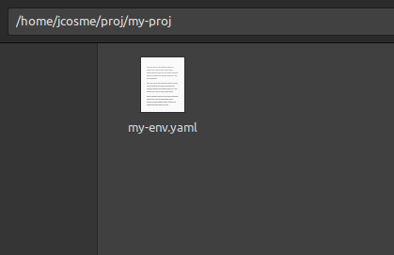
Export conda environments
When exporting conda environments, the yaml file will be created in the current directory.
1. Activate the conda environment
conda activate {your-env-name}
In our example, we start in the following directory:
/home/jcosme/proj/my-proj
2. Run the export command (use mamba)
mamba env export > {env-export-file-name}
1
2
3. (optional) deactivate and delete environment

Slide 18
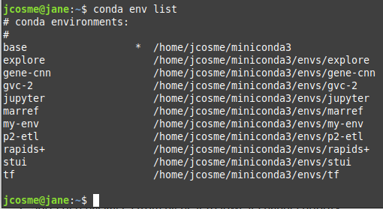
Recreate conda environments
1. Start in the directory with the yaml file
3. Run the following command (use mamba)
mamba env create -n {your-env-name} -f {env-export-file-name}
The key is the ‘-f’ flag, which tells conda to create an environment from a file.
The ‘-n’ flag is optional in this case, as the yaml file already contains a name. If you want to use the environment name from the file, omit the ‘-n’ flag:
2. Make sure the environment name doesn’t already exist
mamba env create -f {env-export-file-name}
In our example, I could use the following to create the ‘my-env’ environment
mamba env create -f my-env.yaml

Slide 19
Miscellaneous

Slide 20
Using pip
The preferred way of installing is using mamba/conda.
Sometimes mamba/conda don’t have the package version you need.
In these cases, you can use pip
However, if you must you pip:
Use mamba/conda to install everything that you can
Use pip at the end

Slide 21
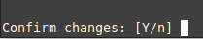
Skip installation confirmation
By default, when installing mamba/conda packages, the user will be prompted to confirm the installs
You can skip this confirmation by adding the ‘-y’ flag at the end of an install command
mamba install {package-name} -y
mamba install -c {a-channel} {package-name}={version} -y

Slide 22
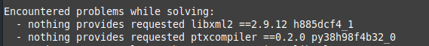
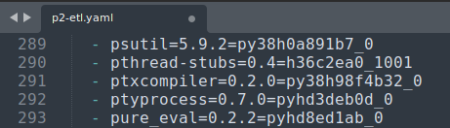
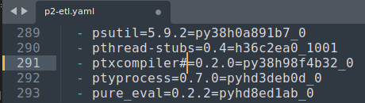
Error recreating environment from yaml file
Sometime, when recreating an environment from a yaml file, you might run into an error that looks like this:
In these situations, open the yaml file, locate the line with the package…
…and comment out anything beyond the name of the package.
This will allow mamba/conda to automatically find a suitable version of the package.

Slide 23
Conda environment variables
It is possible to set environment variables in an activated environment, using the format:
conda env config vars set {env-var-name}={env-var-value}
For example:
conda env config vars set TF_FORCE_GPU_ALLOW_GROWTH=true
To view variables in an activated environment, run:
conda env config vars list
To remove environment variables in an activated environment, use this format:
conda env config vars unset {env-var-name}
For example:
conda env config vars unset TF_FORCE_GPU_ALLOW_GROWTH
Set environment variables will be included in yaml file during exports, and will be set when recreating environments from yaml files.

Slide 24
Thank you!

